Slide 1


PREDICTIVE MODELLING OF
CREDIT CARD APPROVAL
(GOUTHAM YALLAPU, RUHI FAREEDA, SRIRAM REDDY VANGA,
BAHAUDDIN QURAISHI ABDALLAH)

Slide 2




INTRODUCTION
What is credit card approval?
What are the factors involved for an applicant to get his/her credit card approved?
What kind of data we used here?
Why this topic?

Slide 3





RESEARCH QUESTION
Question 1
Question 2
What are the key demographic and financial factors that significantly influence the approval or denial of credit card applications?
How does the approval rate for credit card applications vary across different demographic groups, such as income levels, education backgrounds, and age brackets?

Slide 4


DATA DICTIONARY
APPLICANT ID
APPLICANTGENDER
TOTAL INCOME
INCOME TYPE
EDUCATION TYPE
STATUS
APPLICANT AGE
TOTAL GOOD DEBT
TOTAL BAD DEBT
YEARS OF WORKING

Slide 5



METHODOLOGY
Logistic Regression
Logistic regression is a valuable statistical method for modeling binary outcomes and predicting event probabilities from predictor variables.
ANOVA
ANOVA assesses if independent factors influence a dependent variable by comparing group means and evaluating data variance.
APPLICANTS
Chi Square Test
The Chi-Square test assesses the significance of relationships or independence among categorical variables in a dataset.

Slide 6

DATA CLEANING AND PROCESSING
-The dataset used for this analysis is clean and free from missing values.
-Omitted variables = Owned_Work_Phone, Owned_Email, Owned_Car, Owned_Realty, Total_Children, and Owned_Phone.
-Not directly relevant to the specific research questions that we aimed to address

Slide 7
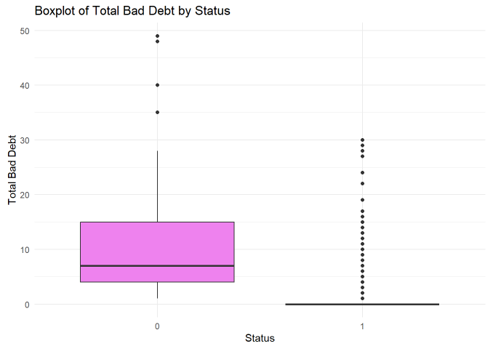
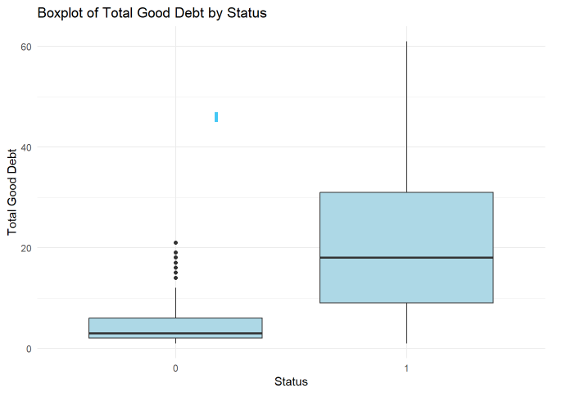
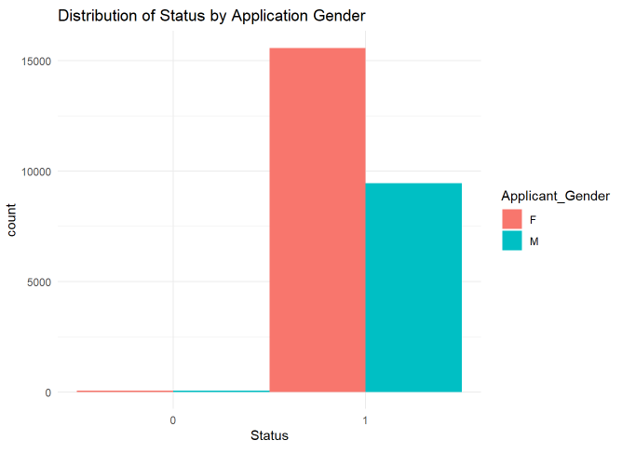
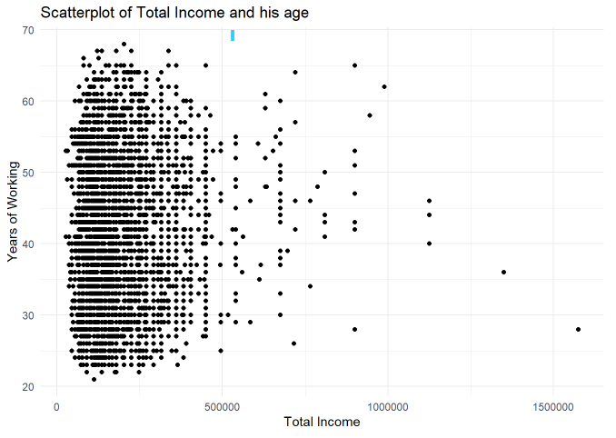
DATA
VISUALIZATION

Slide 8
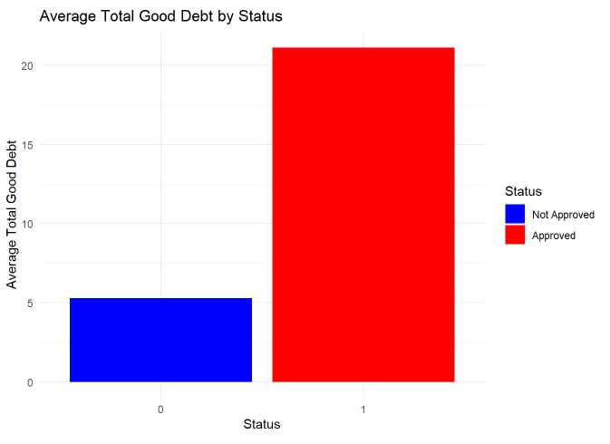
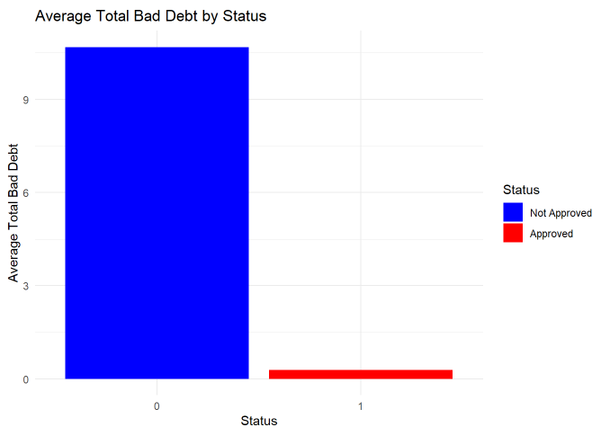
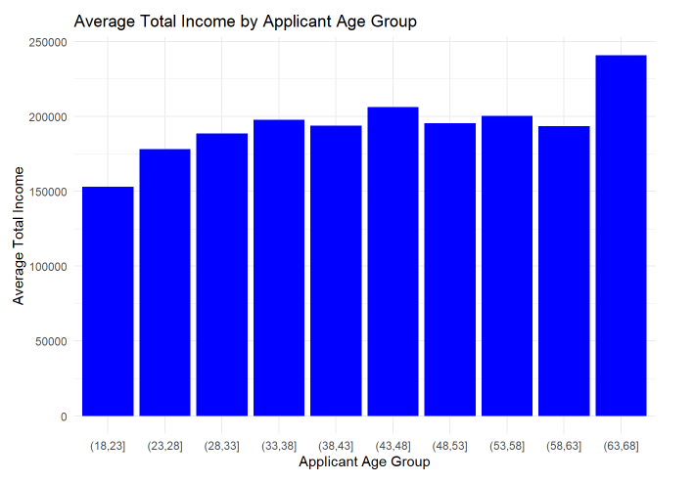

Slide 9

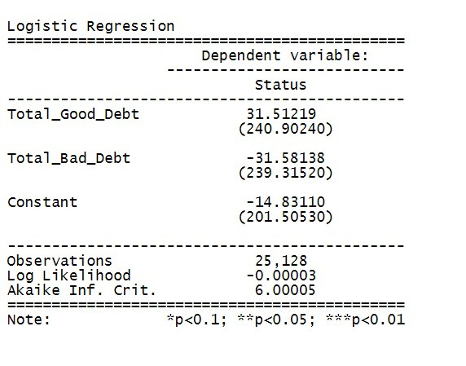
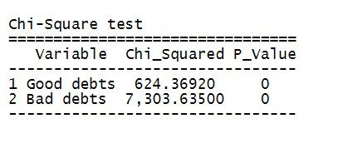
WHAT ARE THE KEY DEMOGRAPHIC AND FINANCIAL FACTORS THAT SIGNIFICANTLY
INFLUENCE THE APPROVAL OR DENIAL OF CREDIT CARD APPLICATIONS?
LOGISTIC REGRESSION
CHI SQUARE TEST
Logistic Regression - both "Total Good Debt" and "Total Bad Debt" coefficients have p-values>0.1, indicating that they are not statistically significant predictors of credit approval status.
Chi-Square - "Good Debts" and "Bad Debts" show significant chi-squared values (624.36920 and 7,303.63500) with very low p-values(0), suggesting a significant association between these variables and the credit approval status.

Slide 10
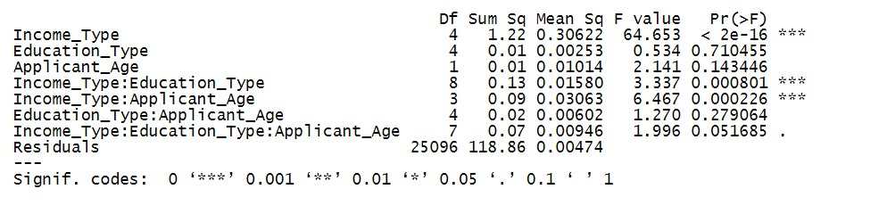
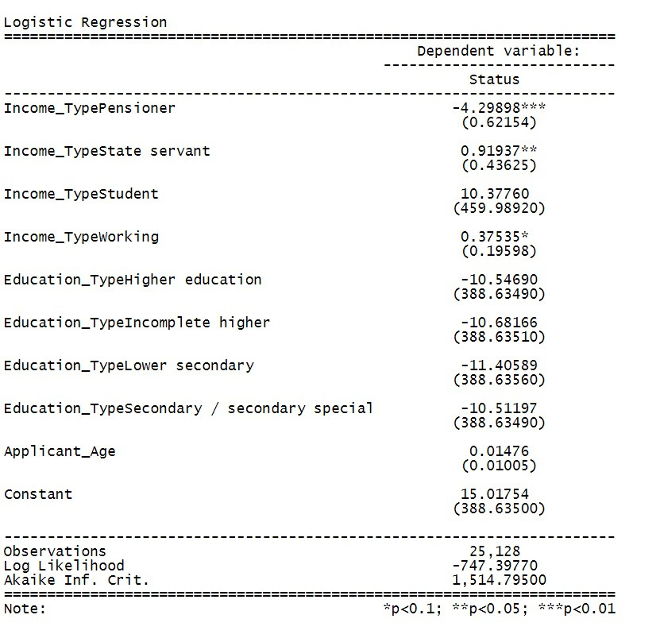
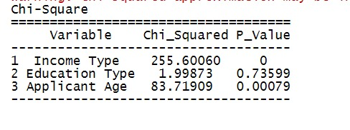
HOW DOES THE APPROVAL RATE FOR CREDIT CARD APPLICATIONS VARY ACROSS DIFFERENT DEMOGRAPHIC GROUPS, SUCH AS INCOME LEVELS, EDUCATION BACKGROUNDS, AND AGE BRACKETS?
A one-unit increase in applicant age results in a small, positive impact on "Status."
Education type has a significant negative effect on "Status."
Individuals categorized as pensioners are significantly less likely to have a positive "Status."
In summary, this logistic regression model indicates the impact of income type, education type, applicant age, and constant on the likelihood of having a positive "Status." Several variables, such as higher education and being a pensioner, have significant effects.

Slide 11
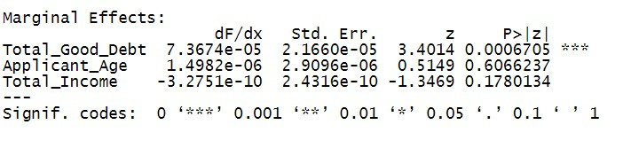
HOW DOES THE APPROVAL RATE FOR CREDIT CARD APPLICATIONS VARY ACROSS DIFFERENT DEMOGRAPHIC GROUPS, SUCH AS INCOME LEVELS, EDUCATION BACKGROUNDS, AND AGE BRACKETS?
Total Good Debt:
A one-unit increase in Total_Good_Debt is associated with a small increase in the probability of the dependent variable. This effect is highly statistically significant.
Applicant Age:
A one-unit increase in Applicant_Age is associated with a very small increase in the probability of the dependent variable. This effect is not statistically significant.
Total Income:
A one-unit increase in Total_Income is associated with a very small decrease in the probability of the dependent variable. This effect is not statistically significant.

Slide 12


CONCLUSIONS

